Slide 1
AI-Powered Insights for Heart Disease Risk Assessment
Presented By:
Sai kumar reddy (2203031240429)
Shabari (2303031247049)
S Preetam (2303031247047)
Aditya(2303031240447)
Guided By:
KIRAN MACWAN MAM
AI & AIDS Department
PIET, Parul University
Mid Project Presentation February, 2025

Slide 2
Content
Introduction
Problem Statement
Flow chart of the system
Analysis
  Functional Requirements
  Use Case Diagrams
  Non-functional requirements
Design:
  UML diagrams
    Class Diagram
    Sequence Diagram
    Activity Diagram
Conclusion
Future Work
References
Project Presentation 2023

Slide 3
Introduction
Heart disease remains one of the leading causes of morbidity and mortality worldwide. Early detection and risk assessment play a crucial role in prevention and management. Artificial Intelligence (AI) has emerged as a powerful tool in healthcare, offering precise and efficient methods for assessing heart disease risk.
AI in Heart Disease Risk Assessment
AI leverages machine learning (ML) and deep learning algorithms to analyze vast amounts of medical data, including electronic health records (EHRs), imaging, genetic information, and lifestyle factors. These AI-driven models can identify patterns and predict the likelihood of developing heart disease with high accuracy.
Project Presentation 2023

Slide 4
Problem Statement
Heart disease remains a leading cause of death globally, with millions of people at risk due to genetic, lifestyle, and environmental factors. Traditional risk assessment methods often lack precision and fail to detect early warning signs. There is a need for advanced, data-driven solutions to improve early detection, personalize treatment, and enhance continuous monitoring. AI-powered technologies offer a promising approach to addressing these challenges by leveraging vast amounts of healthcare data to deliver accurate and timely risk assessments.
Project Presentation 2023

Slide 5
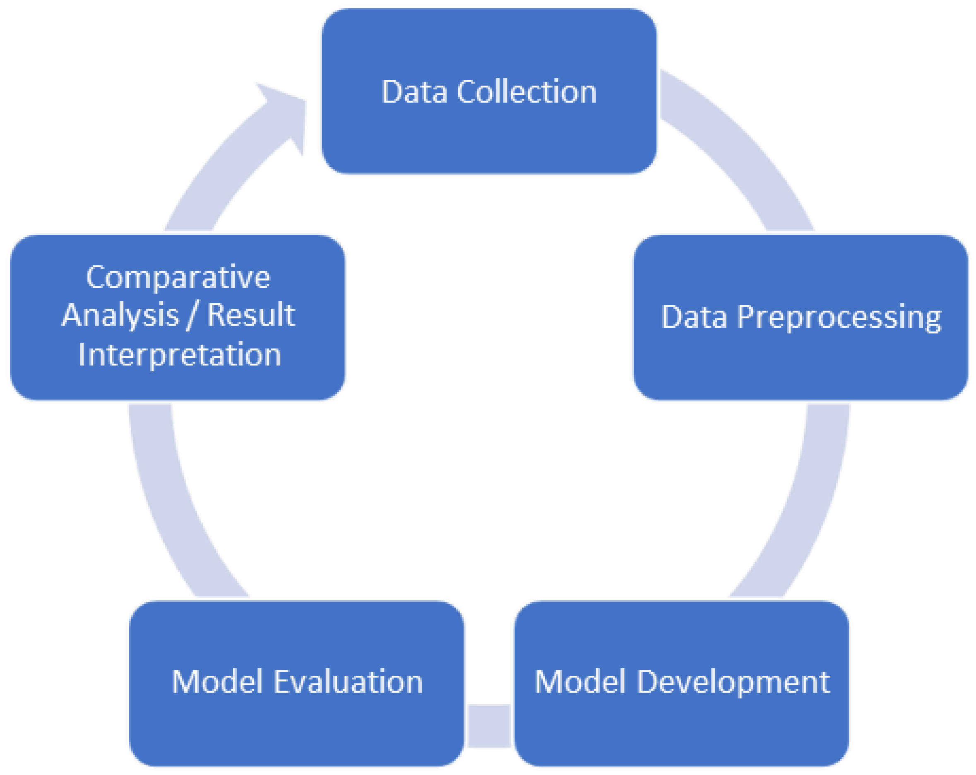
Flowchart of the system
Project Presentation 2023

Slide 6
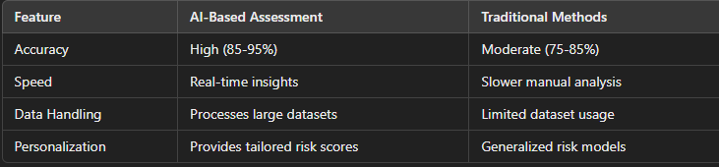
Analysis
1. Effectiveness of AI in Risk Prediction
AI models, particularly machine learning (ML) and deep learning (DL), have shown higher accuracy in predicting heart disease risks compared to traditional statistical models. Studies suggest AI can achieve an 85-95% accuracy rate, surpassing conventional methods like the Framingham Risk Score (~75-85%).
Key advantages:
Detects hidden patterns in patient data
Handles large-scale datasets efficiently
Reduces human errors in diagnosis
2.Comparision Ai vs traditional methods:
Project Presentation 2023

Slide 7
Analysis
3.Challenges & Limitations
Data Bias: AI models trained on biased datasets may yield inaccurate predictions for underrepresented populations.
Privacy Concerns: Handling sensitive patient data raises ethical and regulatory issues.
Interpretability: Some AI models (e.g., deep learning) function as "black boxes," making it hard for doctors to understand their reasoning.
4. Future Outlook
Integration with Wearables: Continuous monitoring through smart devices (Apple Watch, Fitbit) enhances early risk detection.
Hybrid AI Models: Combining AI with traditional medical knowledge can improve interpretability and accuracy.
Regulatory Frameworks: Stricter guidelines (FDA, EU MDR) will ensure AI safety and reliability in healthcare.
Project Presentation 2023

Slide 8
Design
UML Design for AI-Powered Heart Disease Risk Assessment System
This system consists of multiple components, including patients, doctors, AI models, and data processing units. Below is an in-depth theoretical design for UML diagrams, covering Class, Sequence, and Activity Diagrams.
1. Class Diagram (Structural Representation)
Objective
The Class Diagram represents the static structure of the system, including the relationships between patients, doctors, health data, AI models, and risk assessments.
2. Sequence Diagram (Behavioral Representation)
Objective
The Sequence Diagram depicts the interactions between patients, the system, AI models, and doctors during risk assessment.
3. Activity Diagram (Workflow Representation)
Objective
The Activity Diagram visualizes the workflow of AI-powered heart disease risk assessment from data input to treatment recommendation.
Project Presentation 2023

Slide 9
Conclusion
AI-powered heart disease risk assessment offers greater accuracy, efficiency, and personalization but must overcome data biases, privacy concerns, and regulatory hurdles. The future will see increased AI-human collaboration to improve cardiovascular health outcomes.
Project Presentation 2023

Slide 10
Future Work
Future Work for AI-Powered Heart Disease Risk Assessment System
To enhance the accuracy, efficiency, and accessibility of the AI-powered heart disease risk assessment system, several areas for future improvements can be explored:
Project Presentation 2023

Slide 11
References
1. Research Papers & Journals
1.Deep Learning for Cardiovascular Disease Prediction
Rajkomar, A., Oren, E., et al. (2019). "Scalable and Accurate Deep Learning for Electronic Health Records." npj Digital Medicine.
DOI: 10.1038/s41746-019-0121-4
2. Machine Learning in Cardiovascular Risk Assessment
Krittanawong, C., Zhang, H., Wang, Z., Aydar, M., & Kitai, T. (2017). "Artificial Intelligence in Precision Cardiovascular Medicine." Journal of the American College of Cardiology (JACC).
DOI: 10.1016/j.jacc.2017.12.059
3. Wearable Technology for Heart Disease Prediction
Weng, S.F., Reps, J., Kai, J., Garibaldi, J.M., & Qureshi, N. (2017). "Can Machine-Learning Improve Cardiovascular Risk Prediction?" Scientific Reports.
DOI: 10.1038/s41598-017-06948-0
Project Presentation 2023

Slide 12
Thank you
Project Presentation 2023

